Slide 1


Dibs LightLinks
Sponsored By:
Group 35
Matthew Bolan - EE
Evan Boyar - EE
Nicholas Cain - CpE
Ronauldus Woods - CpE

Slide 2
Motivation
•Utility and Versatility
•Moving around a dark house at night (e.g. going to the bathroom, midnight snack, etc.)
•Trying not to wake anyone else

Slide 3
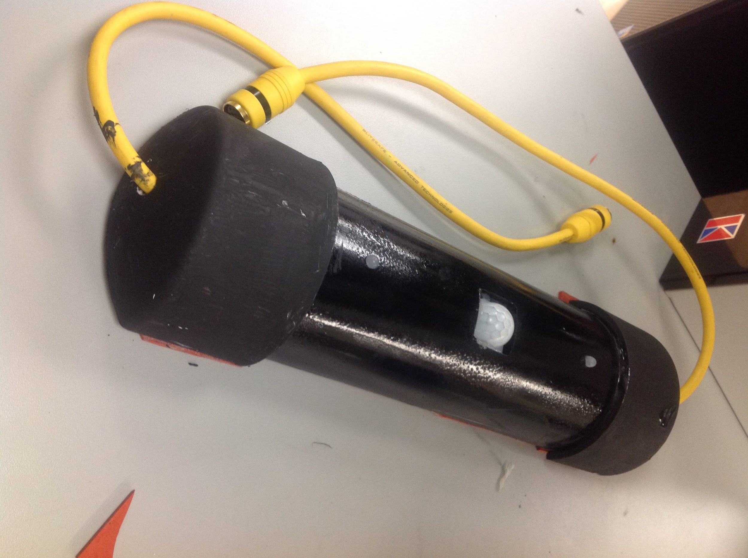
What is it?
Dibs LightLinks System is a series of portable, interconnecting, lighted pathway blocks, or “Links”
Links comes in 3 flavors: Standard, Door, and Interface
Link Connector
Variety of uses

Slide 4
Goals and Objectives
Portable
Safe
Multi-colored, low level lighting
Utilizes Bluetooth to communicate with the user
Several modes of operation

Slide 5
Specifications
<5 ms turn on delay per link due to detection delay
<2 s latency with mobile communication
2 kg maximum mass
Each link shall be less than 300 cm by 8 cm by 4 cm, (l, w, h)
Shall accept and pass on signals sent along any relevant signal lines
Each link shall draw no more than 2 W of power
Each link shall be able to detect motion within 2 meters of it

Slide 6
Overall constraints
Classes
Housing
Jobs
No direct light for IR sensors
Off the shelf issues

Slide 7
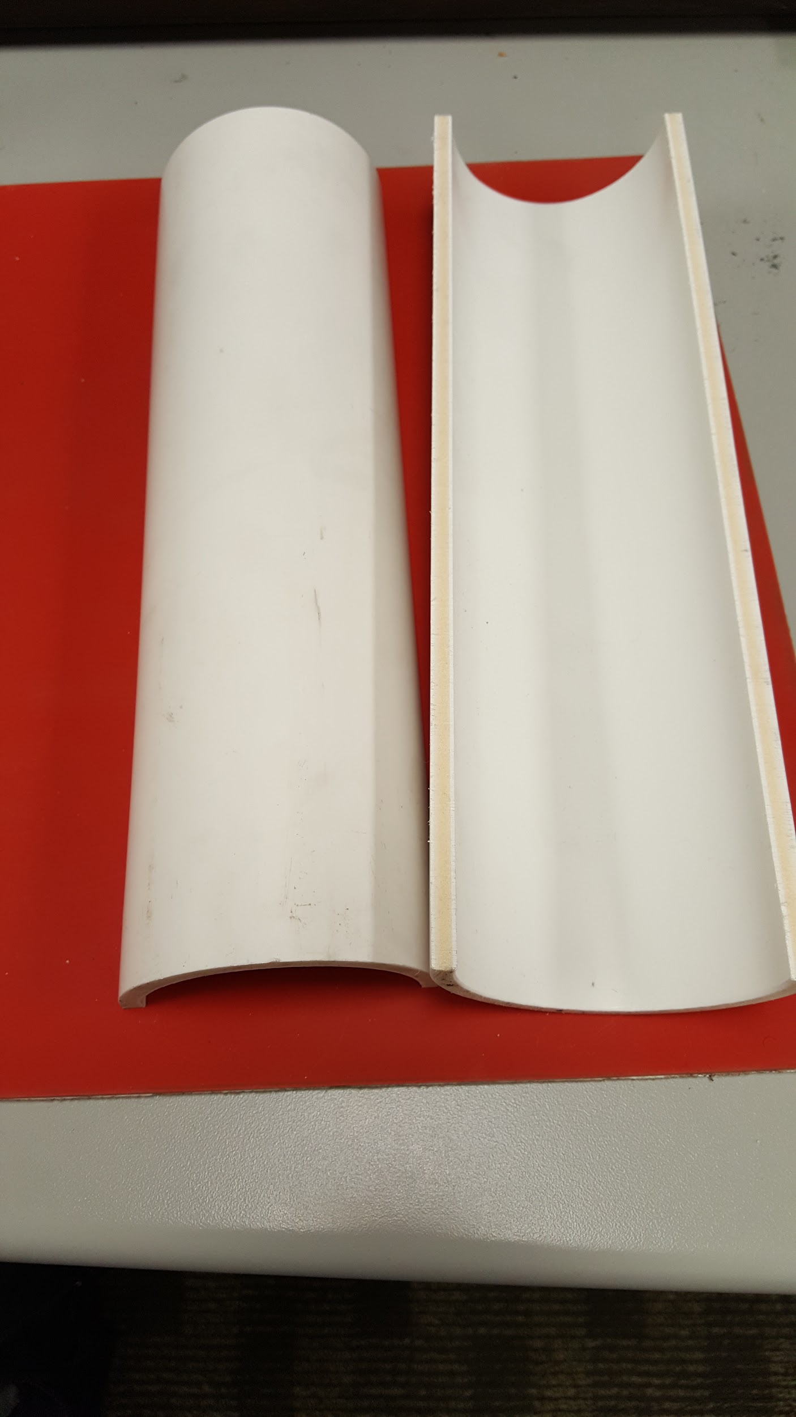
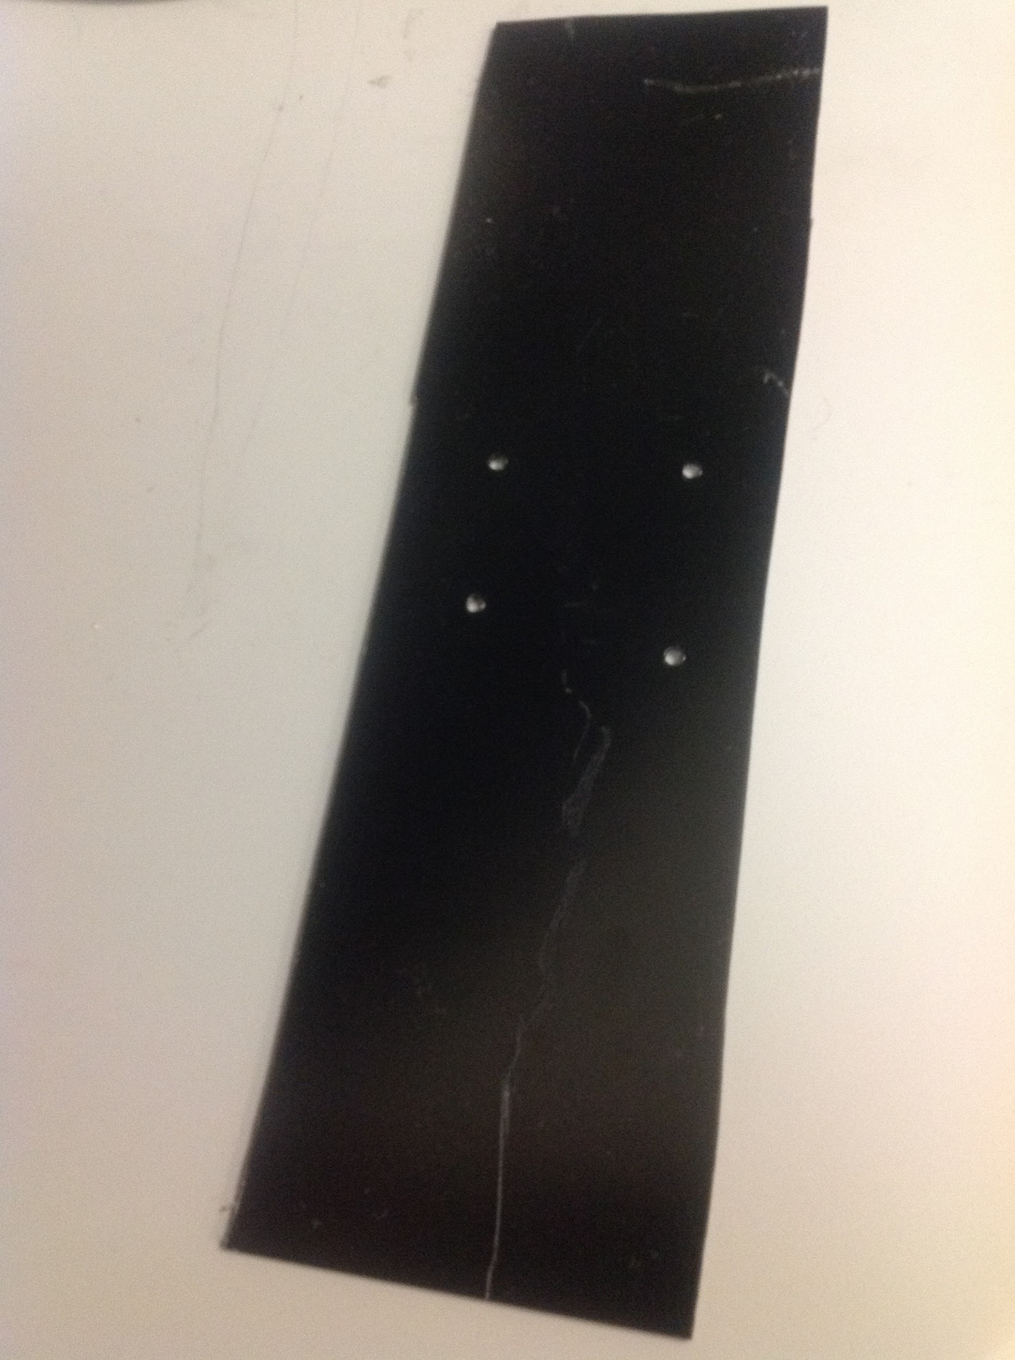
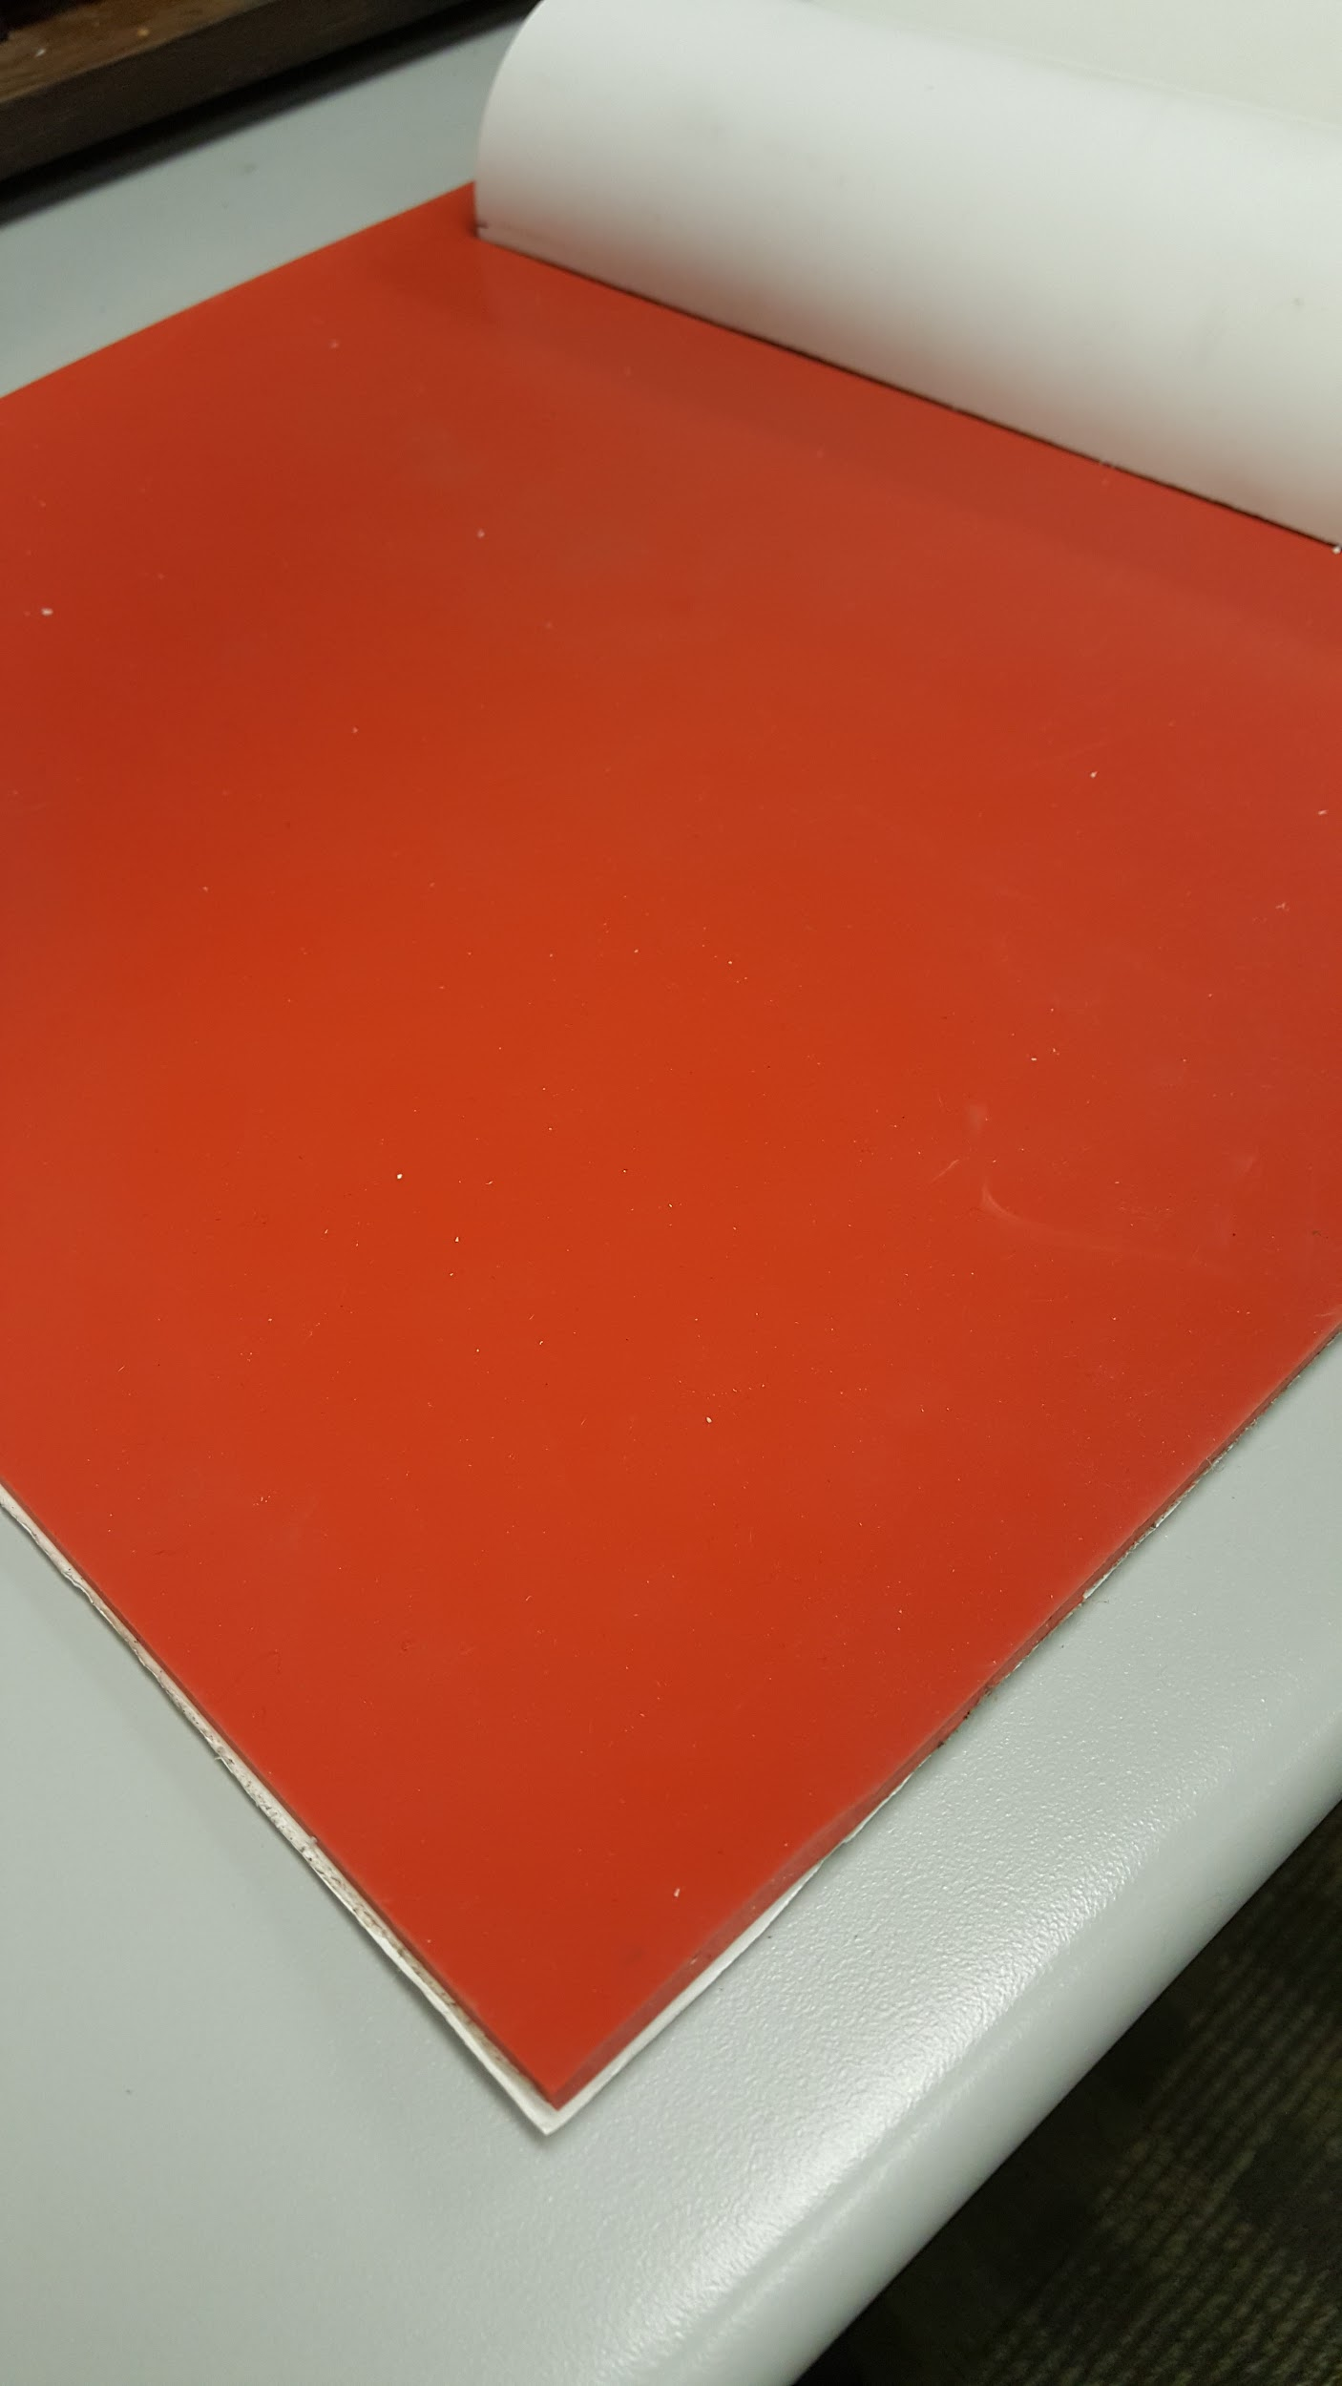
Physical Construction
Half PVC pipe Plastic Base Rubber Base

Slide 8
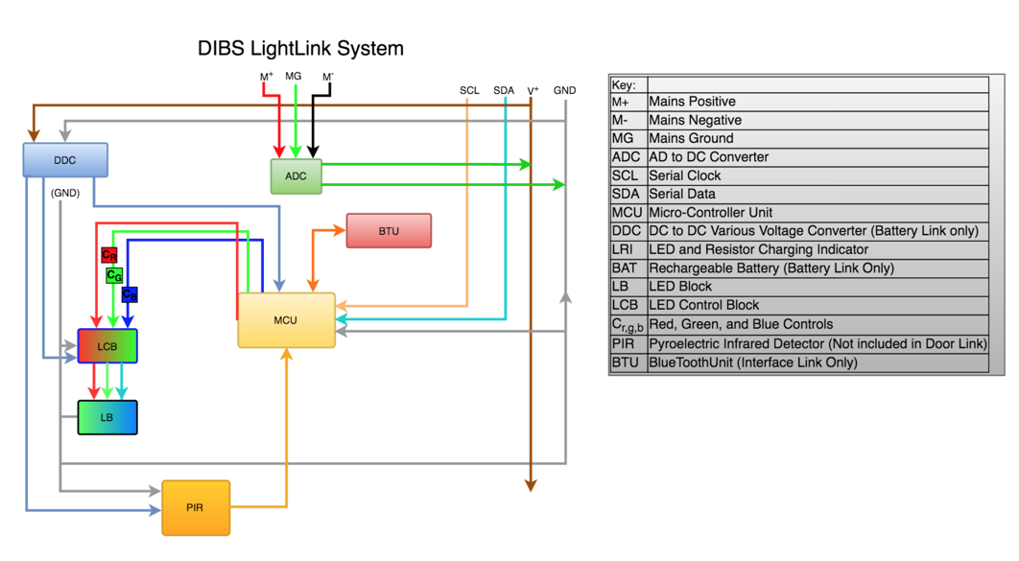
Block Diagram

Slide 9
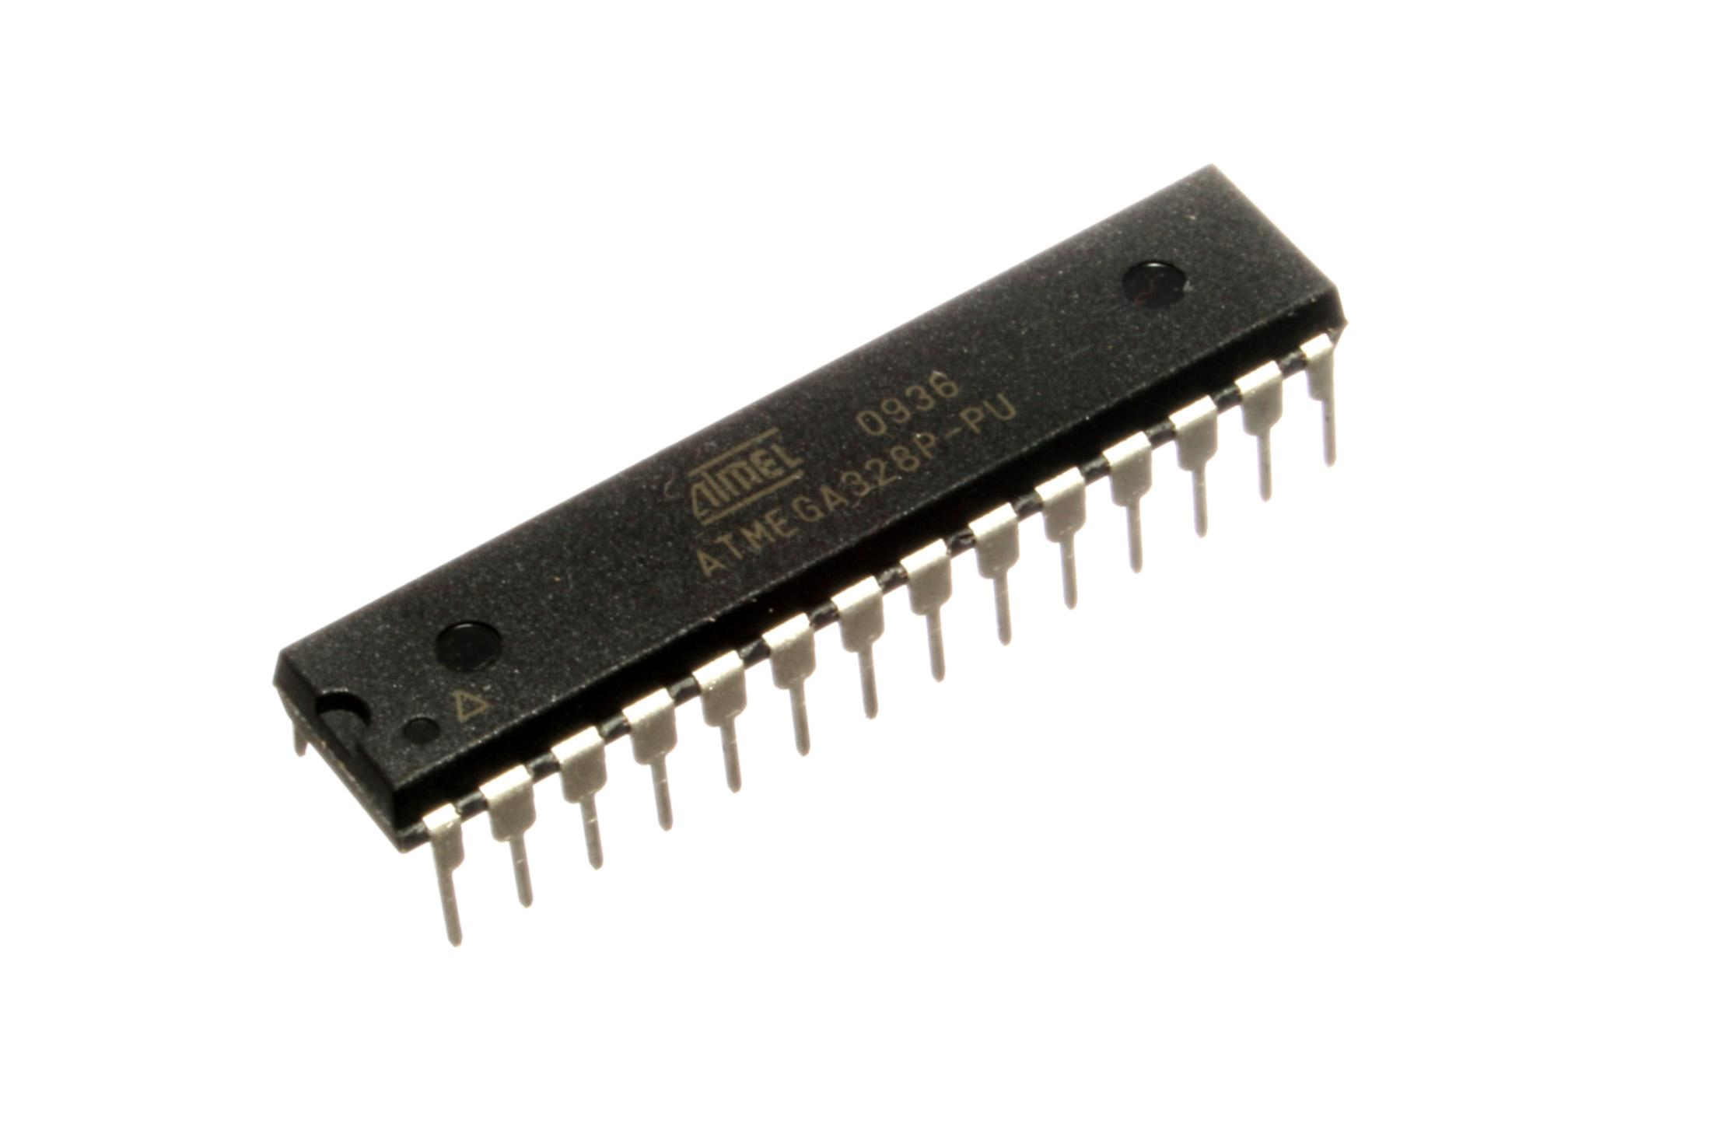
Board Design - Main MCU
Chip: Atmega328P
Inexpensive
Well-documented/libraries
  I²C
  Bluetooth (HC-05)
28-pins (26 I/O max)
DIP packaging (0.3”)
Memory (2 KB) and storage space (32 KB)
~1 MIPS
5V

Slide 10
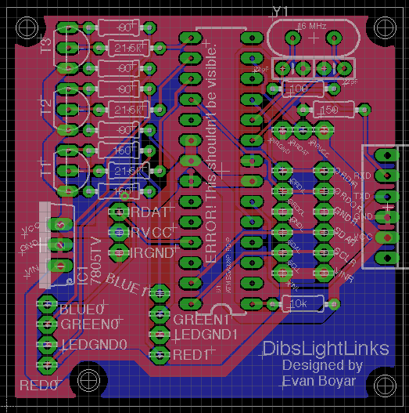
Board Design - Design Philosophy
Modularity
  General-purpose board
  dirtypcb.com
Open hardware
  Removable, re-programmable MCU

Slide 11
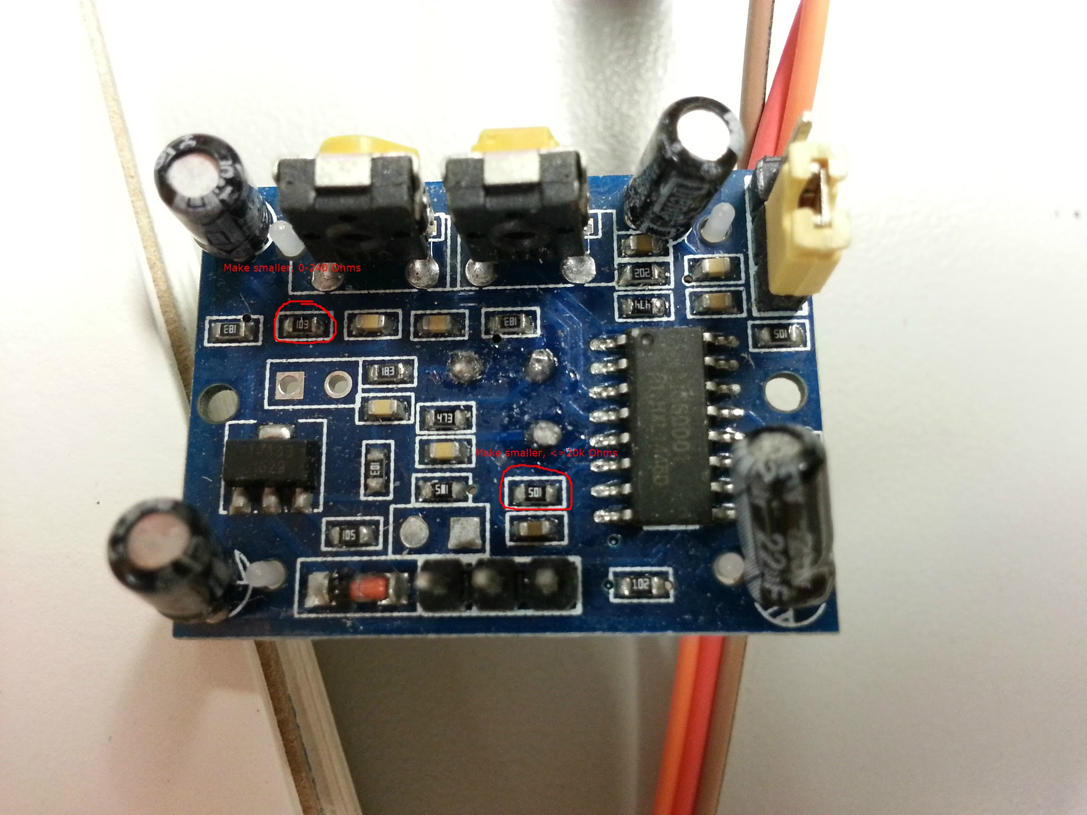
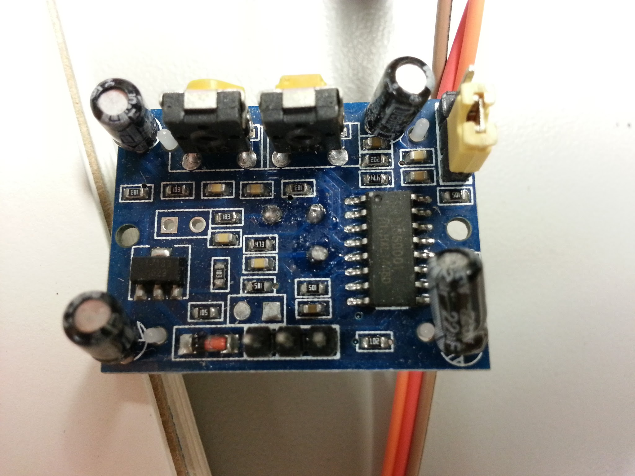
Sensors - PIR
Benefits
  Lower power requirements than sonar
  Clear digital signal
Challenges
  T_{ON}
  T_{non-retriggerable}

Slide 12
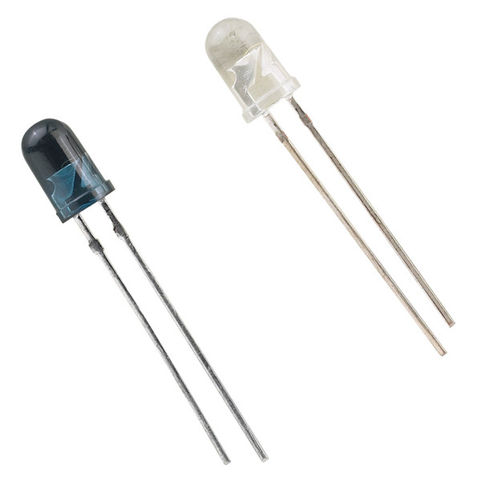
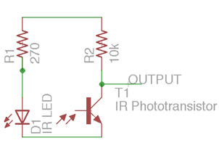
Sensor - IR LED
Door Link
Signal rejection
  38 kHz model
Simple model: RadioShack #2760142
  Emitter
    Reverse voltage: 5V
    Cont. forward current: 150mA
    Forward voltage: 1.3V typical, 1.7V max
  Detector Specs (max)
    VCEO (collector to emitter): 70V
    VECO (emitter to collector): 5V
    IC (collector current): 50mA
    Total power dissipation : 150mW
    Angle of half sensitivity: +/- 20°

Slide 13
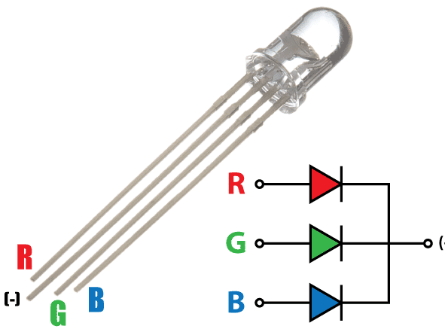
LEDs
RGB (YSL-R596CR3G4B5C-C10)
Power:
  20 mA at
    R: 1.7V
    G: 2.1 V
    B: 3.4 V
  600 mW
  Operate at 5V with resistor

Slide 14
Wireless Communications
Bluetooth
  Short Range (up to 100m in Class 1)
  Easier to Implement
  Moderate Security (Initial handshake can be intercepted)
  Speeds up to 25 Mbps

Slide 15
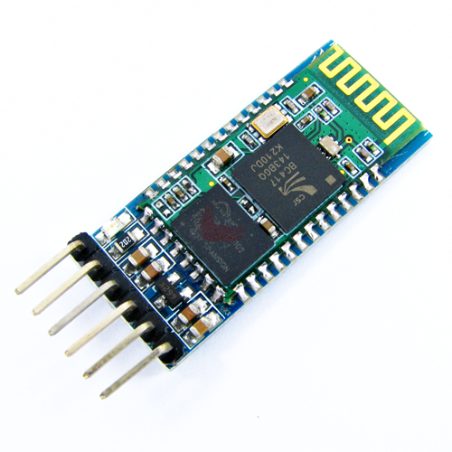
Bluetooth Module - HC-05
115200 baudrate
Class 2 Bluetooth
30 ft range
IEEE 802.15.1 Standard

Slide 17
Modes of Operation
Active Modes - Lights are enabled
Standard Pathway Mode: Default mode - Basic functionality. Lights ON/OFF
Power Saving Pathway Mode - Standard but lights turn off when pass
Crowd Mode - Creates a guide for crowd with lights
Party Mode - Changes between a set of colors based on a timer
Passive Modes - Lights are not enabled
Security Mode - Basic Security around the house
Sleep Mode - System is on but does nothing

Slide 18
Mobile Application
Android VS IOS
Programmed in Java
Can create a developers account for free and test on any Android device
Android Studio: Very helpful IDE
Android OS is Open Source: Tons of documentation and help forums
Variety of Android mobile devices
Most devices relatively cheap
Programmed in Objective-C or Swift
$100/year for developers account if want to test on actual IOS mobile device
Xcode: Primary IDE for IOS development
Apple IOS is proprietary information
Limited amount of mobile devices:iPhone, iPad
Devices are expensive

Slide 19
Mobile Application Goals
Communicate to and from BlueTooth-module/microcontroller
Receive alerts if motion detected while in security mode
Configure modes of operation to user’s custom liking

Slide 20
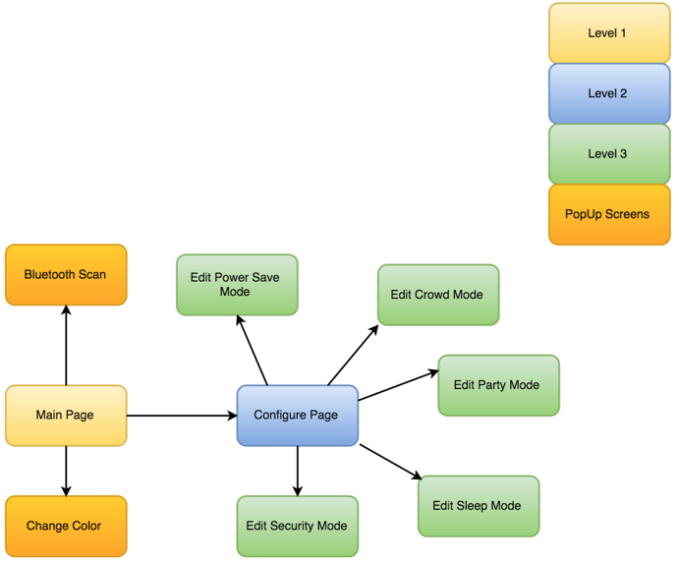
Mobile Application Flow

Slide 21
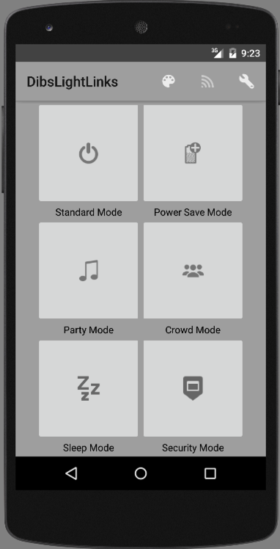
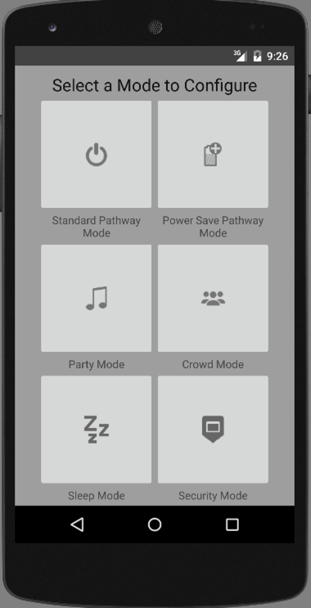
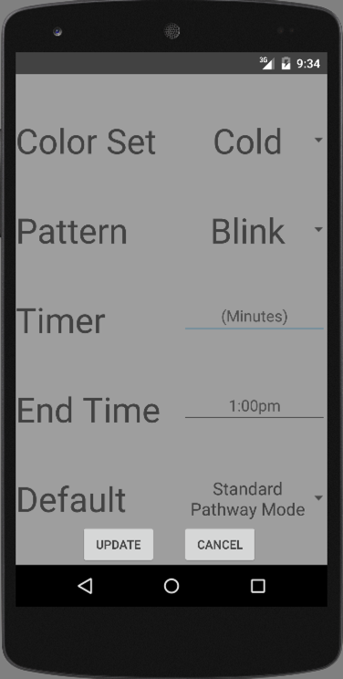
User Interface
Main Page
Configure Page
Party Configure Mode

Slide 22
Administrative Content
 | Matthew | Evan | Nicholas | Ronauldus
Circuit and Board Design | S | P
Microcontroller |  | S |  | P
Management | P | S
Server |  |  | S | P
Physical Construction | P | S
App Development |  |  | P | S
Sensors and LED |  | P |  | S
 |  |  |  | P=Primary
 |  |  |  | S=Secondary

Slide 23
Budget (Projected)
Component | Quantity | Price | Total
LED Lights | 50 | $6.95 | $6.95
ATMEGA328PU MCU | 12 | $3.02 | $36.24
PIR Sensors | 10 | $1.90 | $19.00
IR system | 2 (1 package) | $5.99 | $5.99
Printed Circuit Boards | 10±2 | $14.00 | $14.00
AC/DC Converter | 1 | $15.00 | $15.00
Breadboard | 1 | $15.00 | $15.00
ESP8266-01 | 3 | $6.95 | $20.85
Miscellaneous Materials | - | - | $97.38
Total | - | - | $230.41

Slide 24
Budget (Actual)
Item & Qty | Date | Total Cost
(1x) USB A->B | 2/13/2016 | $5.31
(3x) 2N7000 | 2/20/2016 | $3.83
(1x) 13 Pin Pigtail Connector | 2/20/2016 | $4.26
(1x) (2/pkg) 2.1mm Coax plug | 2/13/2016 | $4.27
(1x) (10/pkg) Bootloaded Atmega328 | 3/13/2016 | $32.76
(1x)(~10/pkg) PCBs | 3/15/2016 | $33.00
(1x)(50/pkg) 22pF Capacitors | 3/13/2016 | $4.39
(2x)(2/pkg) Bootloaded Atmega328 | 3/13/2016 | $10.99
(1x) LANMU UNO R3 | 3/8/2016 | $9.99
(1x) Bluetooth Module | 3/4/2016 | $8.99
(1x) WiFi Bee | 3/4/2016 | $19.95
Item & Qty | Date | Total Cost
(1x) FTDI to USB TTL Serial Adaptor | 2/26/2016 | $5.69
(1x)(10/pkg) Crystal | 2/23/2016 | $5.85
(1x) Addicore ESP 8266 | 2/4/2016 | $6.95
(1x) DIYmall ESP 8266 | 2/4/2016 | $7.99
(1x) 830pt Breadboard + Wires | 12/21/2015 | $9.42
(1x) 400pt Breadboard + Wires | 12/18/2015 | $8.90
(1x)(5/pkg) IR LEDs | 12/12/2015 | $5.79
(1x)(50/pkg) RGB LEDs | 12/12/2015 | $5.13
(2x) IEIK UNO R3 | 12/12/2015 | $10.29
(1x) Addicore ESP 8266 | 12/12/2015 | $6.95
(1x)(10/pkg) PIR sensors | 12/12/2015 | $15.99
Various parts | 4/1/2016 | $30.25
Various equipment | 4/4/2016 | $11.29
Current Total Costs Incurred | Current Budget Remaining | Current Overshoot
$268.23 | $322.76 | $37.82

Slide 25
Questions? Comments?

